Slide 1





Shared Transport
Management System
Team Members:
Atishi Miral 16BLC1003
Malolan 16BLC1033

Slide 2
Problem
People travelling via shared transport, like buses/vans for organisations (corporates, colleges, schools) often face undesirable situations like:-
Transport not arriving on time and panicking due to lack of status of the transport
Transport arriving too early and leaving before time
Driver driving rashly on roads (overspeeding, sudden brakes/jerks)

Slide 3
Solution
Cloud-based system
Live-tracking of transport
Real-time updates to passengers
Streamline boarding process for timely boarding
Collect driver’s analytics
Analyse driver performance

Slide 4
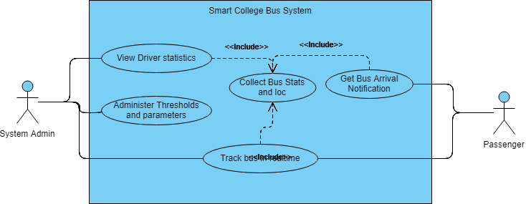
Use Case Diagram

Slide 5
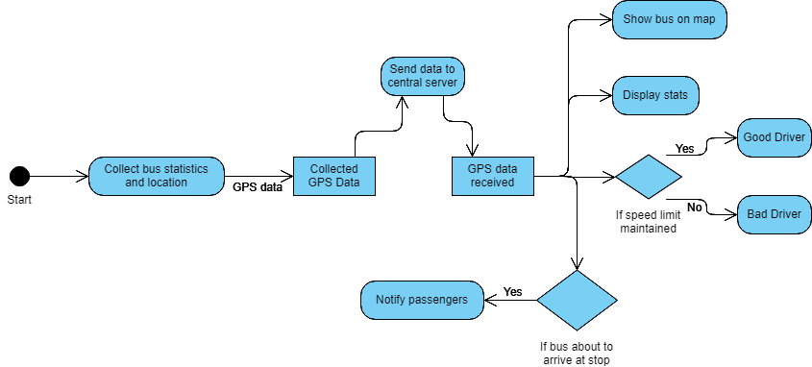
Flow of activity and data

Slide 6
Components used
Hardware:
NodeMCU v1.0 (12E)
GPS Sensor Module (GY-NEO6M by Ublox)
RFID Sensor (MFRC522)
Software:
Arduino IDE
Google Cloud Platform
Google Maps and Roads API
Node.js – Server Backend
Comm. Protocols:
WiFi (IEEE 802.11b/g/n)
MQTT
HTTP

Slide 7
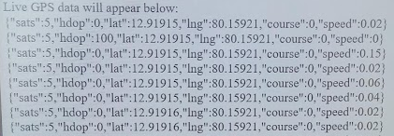
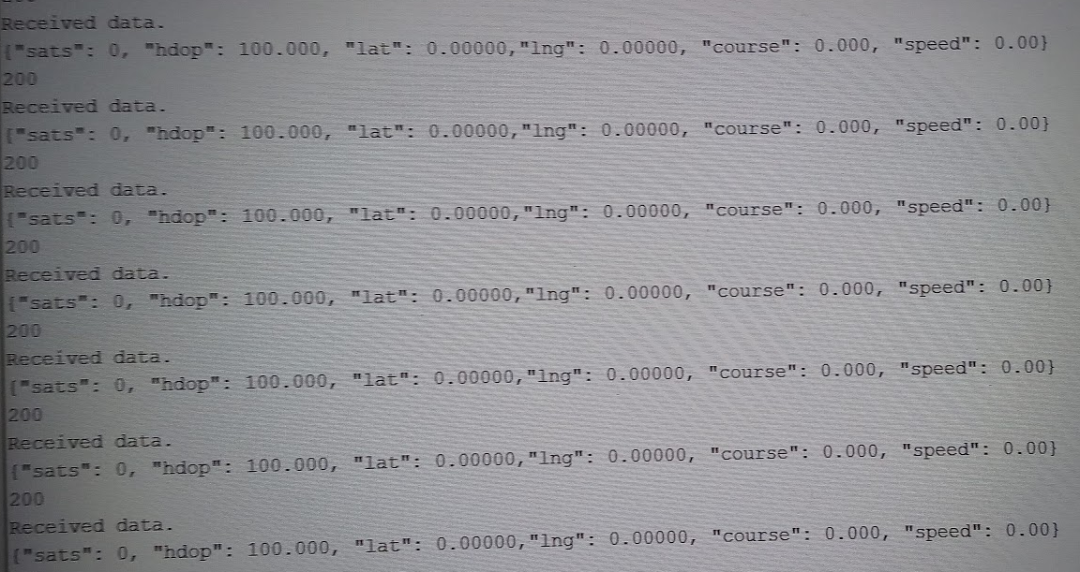
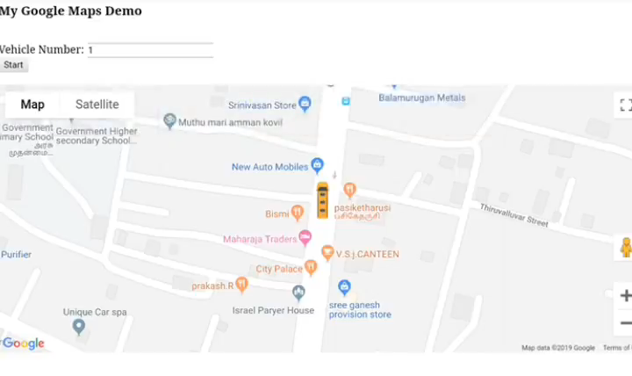
Photos and Screenshots
Sending data through HTTP to the backend and displaying received values on the front end
Sending GPS values from NodeMCU
Vehicle Tracking on the front end with Google Maps

Slide 8
Thank You

